Slide 1
Name: waleed akram roll no : 20p-0640
IS TECHNOLOGY INVADING OUR PRIVACY?

Slide 2

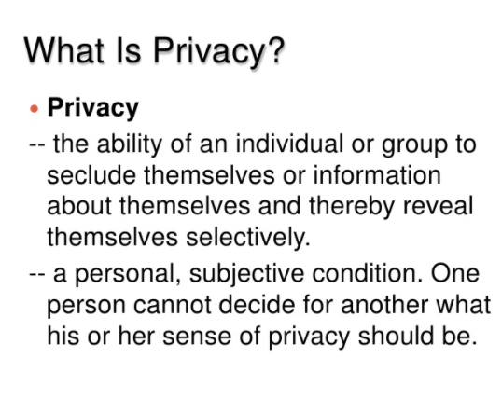

Slide 3
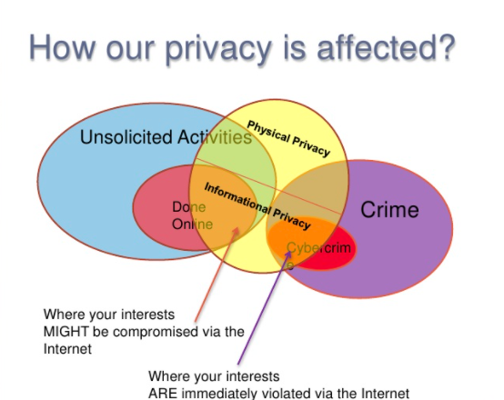


Slide 4
Who is Taking Our Information? people willingly giving information about themselves away on social media. It seems as if no one has any privacy anymore. As actor Will Smith said in a recent interview on the show “I was very dumb when I was 14. See, no Twitter, no Facebook when I was 14. So I was dumb, but I was dumb in private.”

Slide 5

young people, are being exposed to privacy risks through their use of technology. Willingly given or not the formerly private information of the populace is being stored, tracked, and sold to buyers for both legal and illegal use.

Slide 6
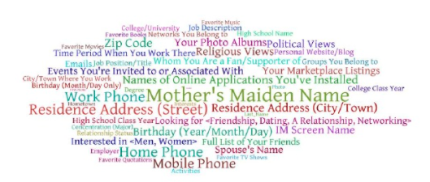
greatest spying machine in the world WikiLeaks founder Julian Assange described the Internet as the “greatest spying machine the world has ever seen” (Kingsley 2011). It is easy to see why he thinks that this is the case. Some of the organizations looking to collect user data are Facebook, Google, and the National Security Administration of the United States.

Slide 7
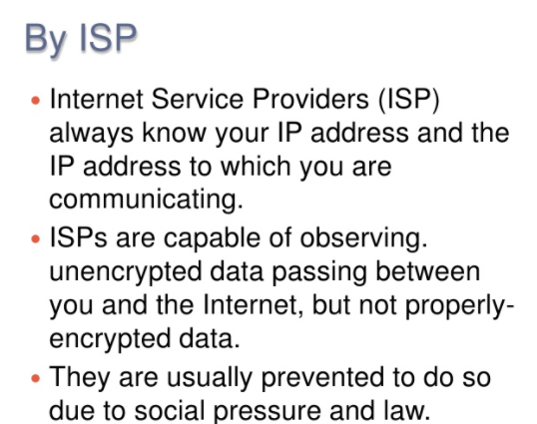

Slide 8
Technical resorts to protect privacy .Antivirus software .firewall .encryption tools

Slide 9
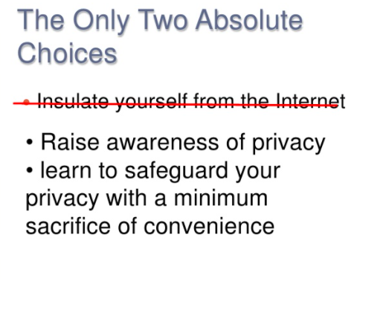

Slide 10

Share as little as possible on social media Use private or secure browsing Use strong and unique passwords Avoid using public Wi-Fi and hot spots

